Slide 1
Class 4

Slide 2
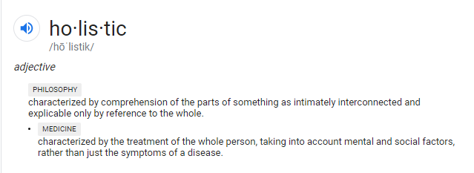
Approaches to Health Care
Culturally Competent: The ability to understand, communicate with and effectively interact with people across cultures.

Slide 3

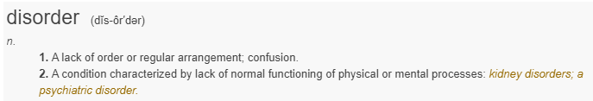
What’s the difference?

Slide 4

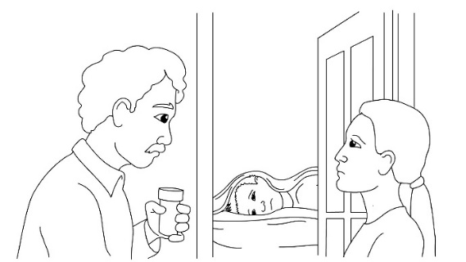
Mood Episodes
Depressive & Manic
Episodes

Slide 5
Depressive Disorder
Indecisiveness
HOPELESS
Changes in Sleep
GUILT
SADNESS
DISTRESS
Isolation
FATIGUE
SUICIDAL
THOUGHTS

Slide 6
Bipolar Disorder
RACING THOUGHTS
Sleeplessness
IMPULSIVE
PRESSURED SPEECH
MANIA
GRANDIOSE IDEAS
AGITATED
Sadness
Elated Mood

Slide 7

Psychotic Episodes

Slide 8



Break – 10 minutes

Slide 9
Schizophrenia
BIZARRE
BEHAVIORS
DISORGANIZED
THINKING
Flat Emotional Response
Delusions
HALLUCINATIONS
WITHDRAWAL

Slide 10
Post-traumatic Stress Disorder (PTSD)
On Edge
EMOTIONAL NUMBNESS
ANGRY
OUTBURSTS
NIGHTMARES
Intrusive Images or Thoughts
HYPERVIGILANCE

Slide 11
Anxiety Disorders
AGORAPHOBIA
Racing Heartbeat
NAUSEA
FEAR
Panic Attack
ANXIETY
Social Phobia
Sweating
Dizziness
HYPERVENTILATION

Slide 12
Obsessive-Compulsive Disorder
Compulsions
FEAR
Obsessions
Intrusive
Thoughts
Or Impulses
GERM PHOBIA
CHECKING
REPETITIVE ACTS
COUNTING

Slide 13
Borderline Personality Disorder
CUTTING
Fear of
Abandonment
ANXIETY
Feelings of Emptiness
DISTORTED
THINKING
SUICIDAL THOUGHTS
Dangerously Impulsive Behavior

Slide 14




Co-Occurring Disorders
Mental Health Condition
+
Substance Use

Slide 15






Experiences with Symptoms

Slide 16

Anosognosia: Lack of Insight
An inability to recognize a disorder or illness that is clinically evident. The formal medical term for this medical condition is anosognosia, from the Greek meaning “to not know a disease.”

